Slide 1
Western Cape Department of Agriculture
Monthly report on fresh fruit sales
at Cape Town Market
June 2026

Slide 2
INDEMNITY
The Western Cape Department of Agriculture prepared this data/information as accurately as possible. However, as this document contains data from various sources, its correctness cannot be guaranteed. Any person using this information will be doing so at own risk and the said organisation or any other party will under no circumstances be responsible for any loss suffered by any person/organisation using the information contained in this document.

Slide 3
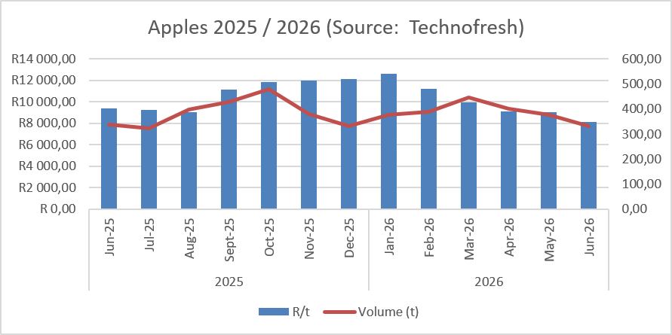
Fresh fruit sales

Slide 4
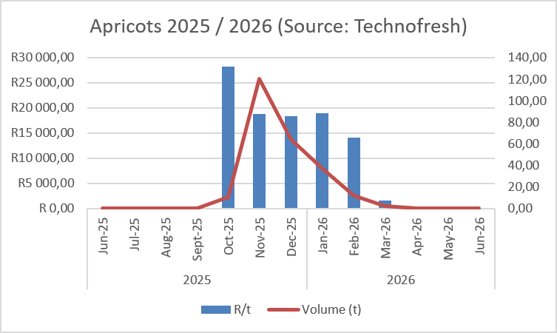
Fresh fruit sales

Slide 5
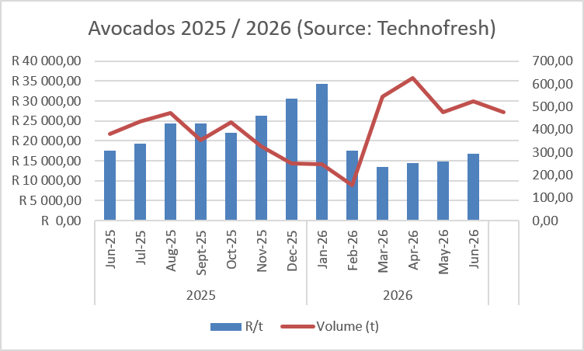
Fresh fruit sales

Slide 6
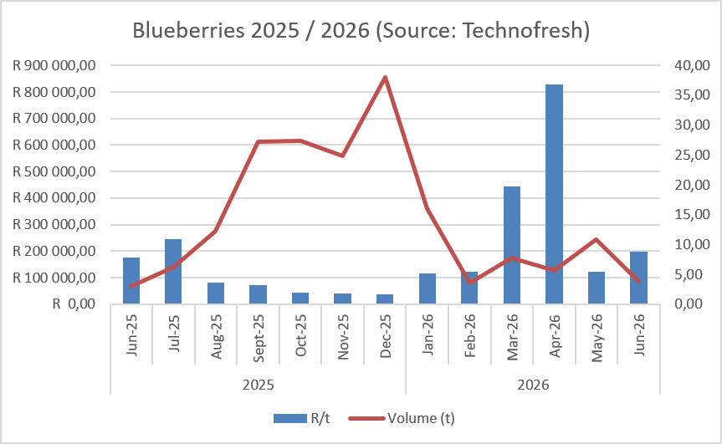
Fresh fruit sales

Slide 7
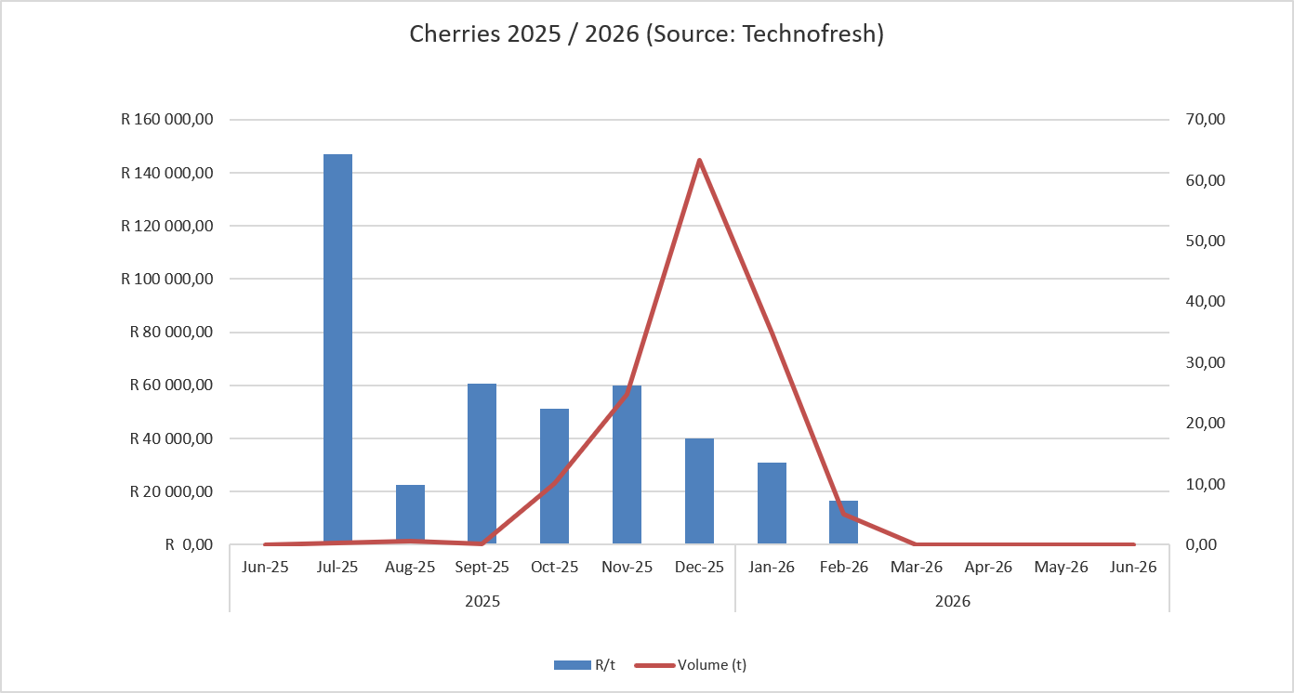
Fresh fruit sales

Slide 8
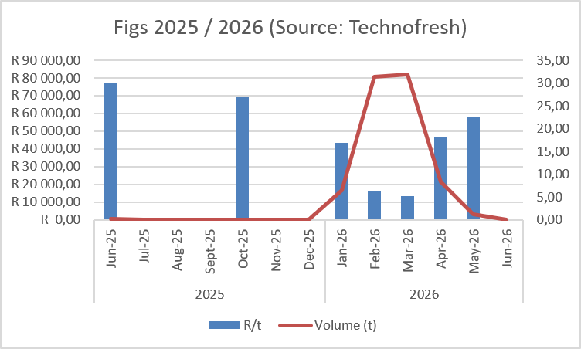
Fresh fruit sales

Slide 9
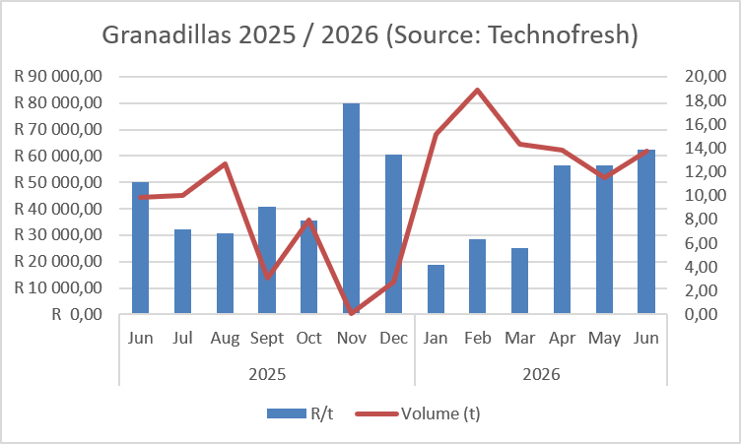
Fresh fruit sales

Slide 10
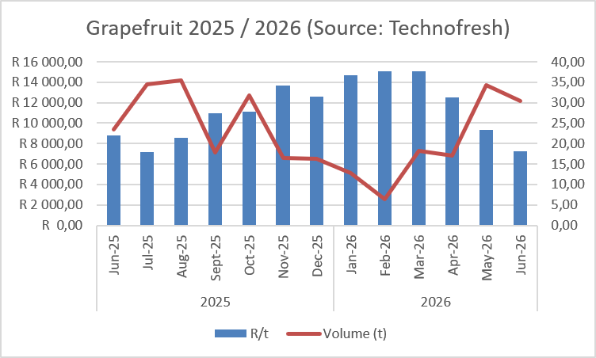
Fresh fruit sales

Slide 11
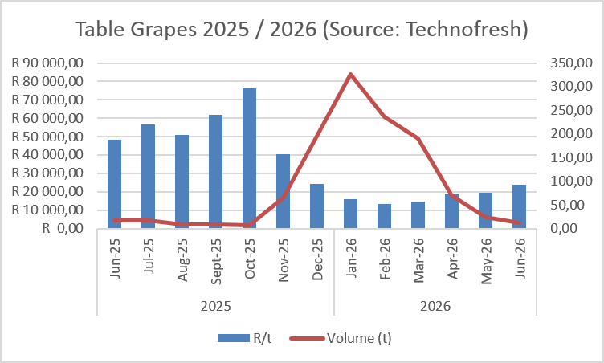
Fresh fruit sales

Slide 12
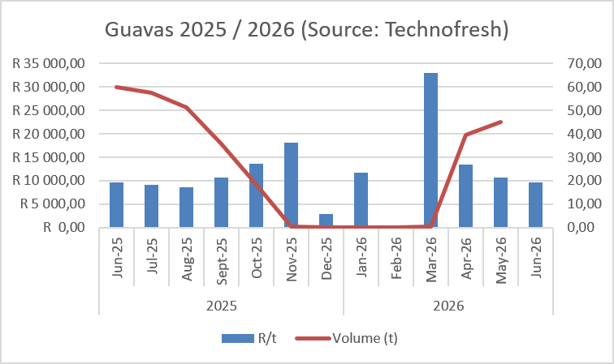
Fresh fruit sales

Slide 13
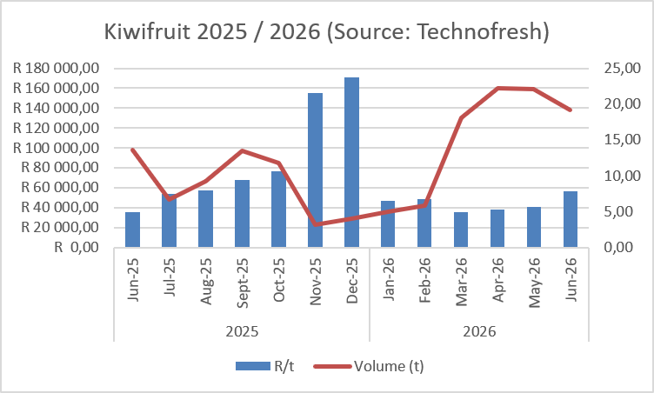
Fresh fruit sales

Slide 14
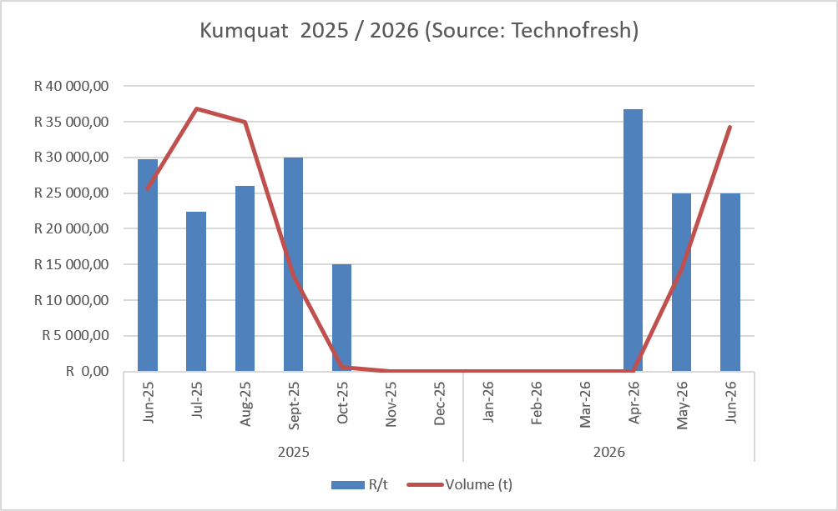
Fresh fruit sales

Slide 15
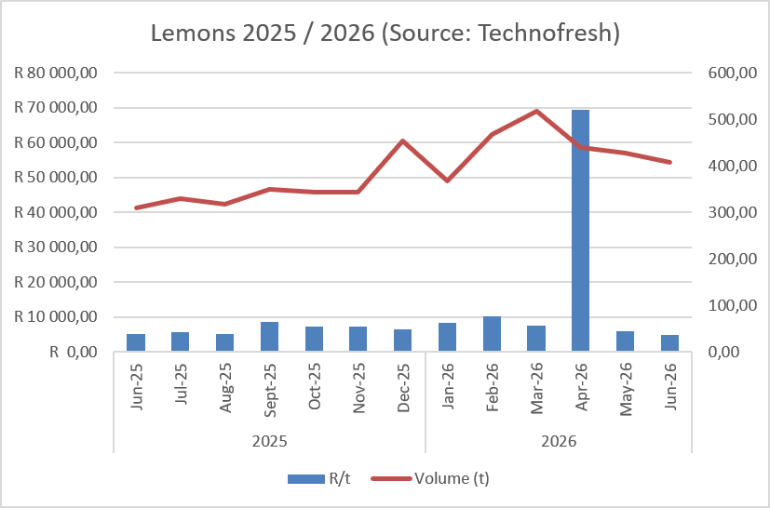
Fresh fruit sales

Slide 16
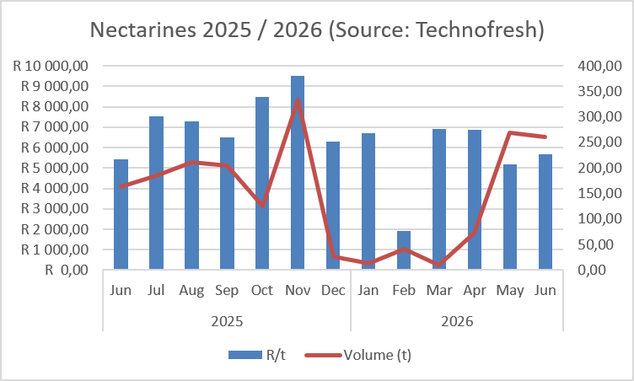
Fresh fruit sales

Slide 17
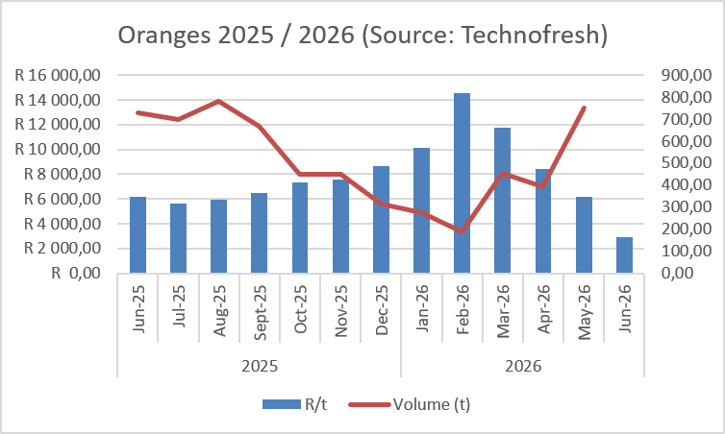
Fresh fruit sales

Slide 18
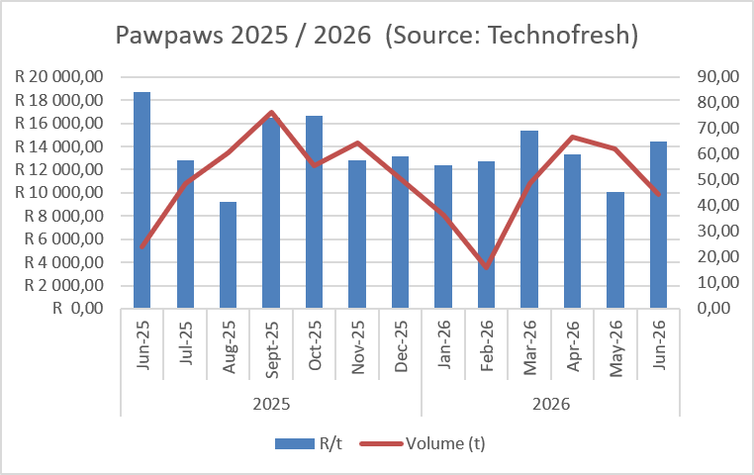
Fresh fruit sales

Slide 19
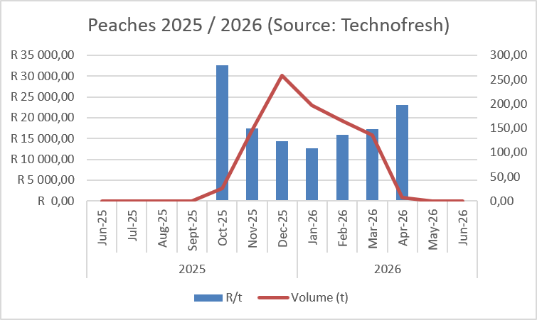
Fresh fruit sales

Slide 20
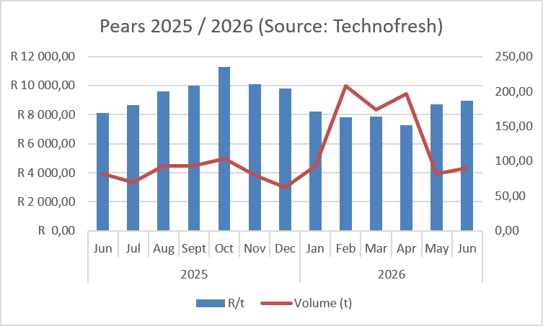
Fresh fruit sales

Slide 21
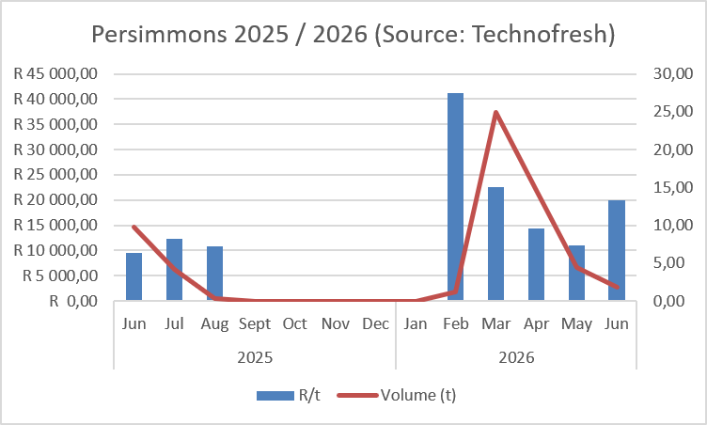
Fresh fruit sales

Slide 22
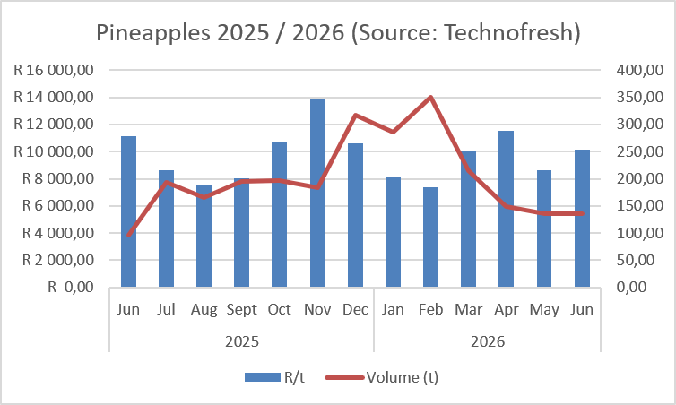
Fresh fruit sales

Slide 23
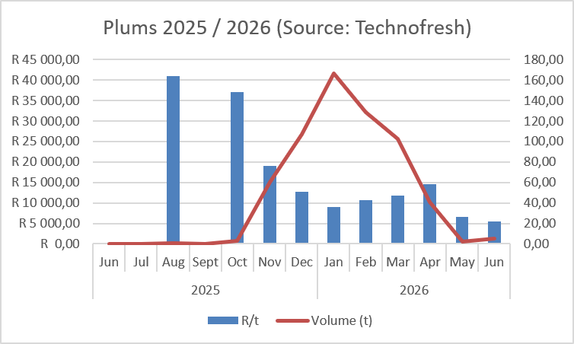
Fresh fruit sales

Slide 24
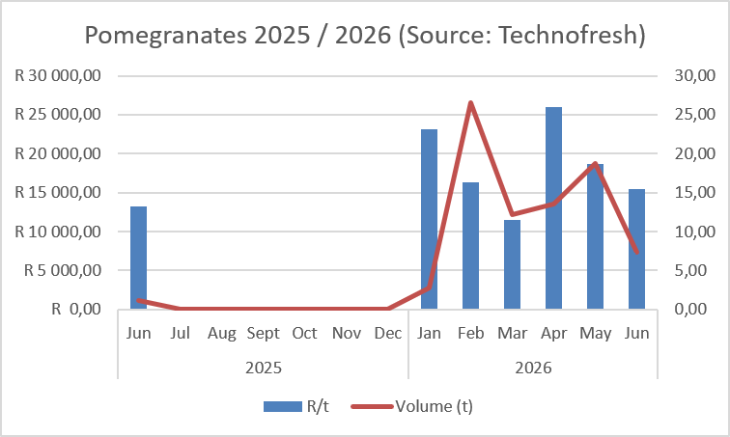
Fresh fruit sales

Slide 25
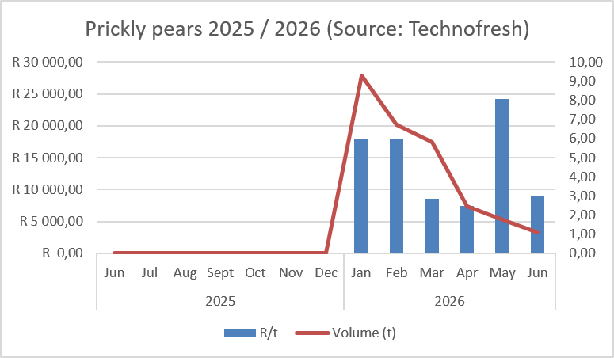
Fresh fruit sales

Slide 26
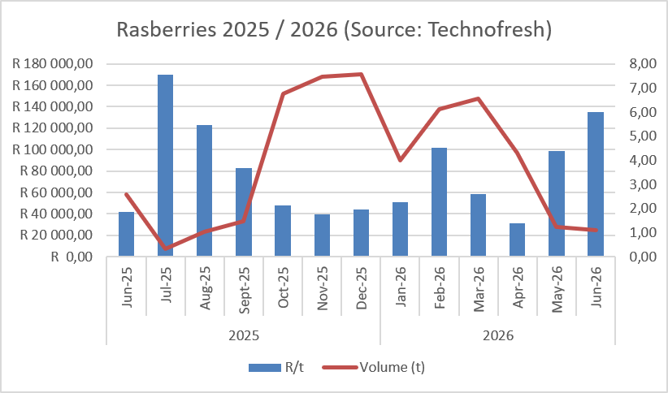
Fresh fruit sales

Slide 27
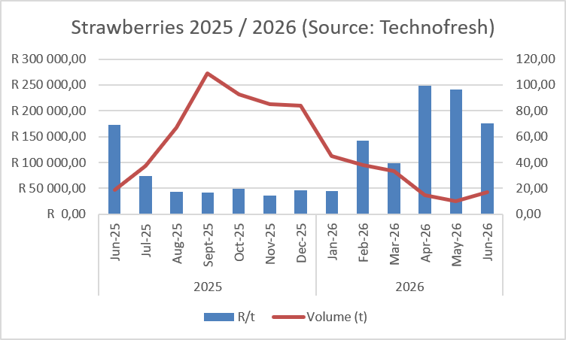
Fresh fruit sales

Slide 28
W Koekemoer
Wilna.Koekemoer@westerncape.gov.za

